Slide 1

JCAPS 5.1 Scheduler/Oracle POC
Phani Krishna

Slide 2
Oracle Database Connectivity
Components Required
  Object Type Definition
  Connectivity Map
  Java Collaboration
  Deployment Profile
  External Systems

Slide 3
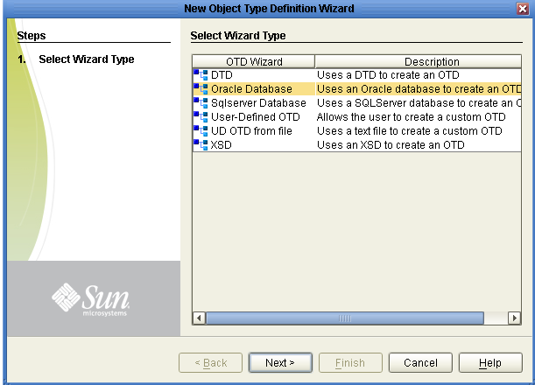
Object Type Definition
(Screen Shot 1)

Slide 4
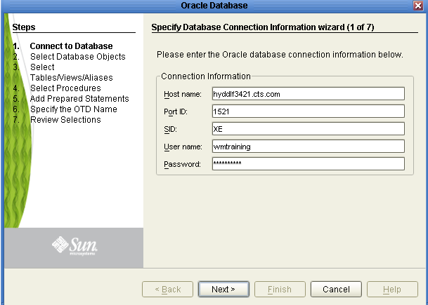
Object Type Definition
(Screen Shot 2)

Slide 5
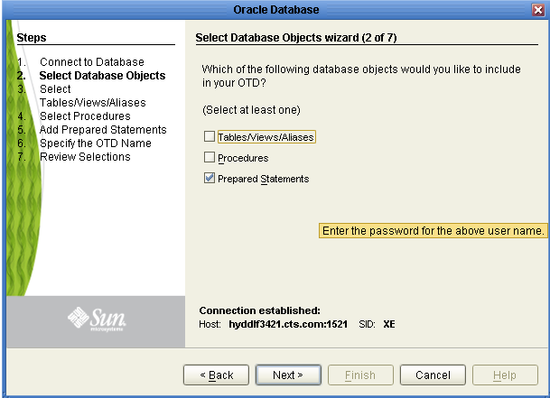
Object Type Definition
(Screen Shot 3)

Slide 6
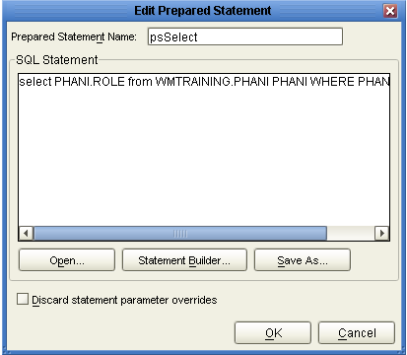
Object Type Definition
(Screen Shot 4)

Slide 7
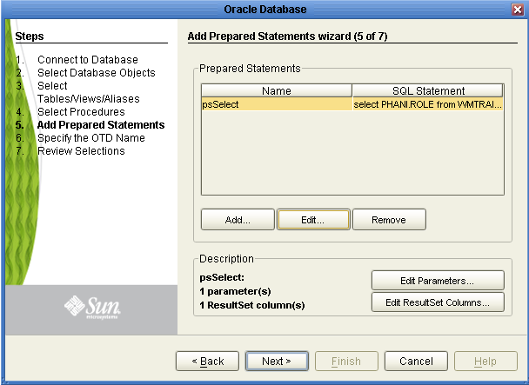
Object Type Definition
(Screen Shot 5)

Slide 8
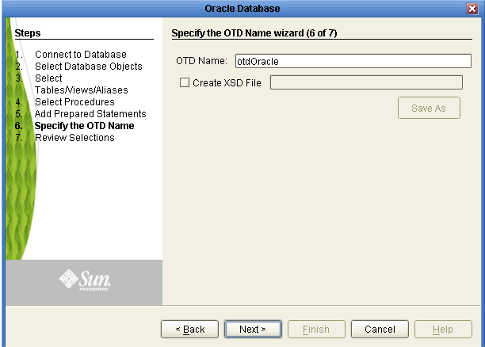
Object Type Definition
(Screen Shot 6)

Slide 9
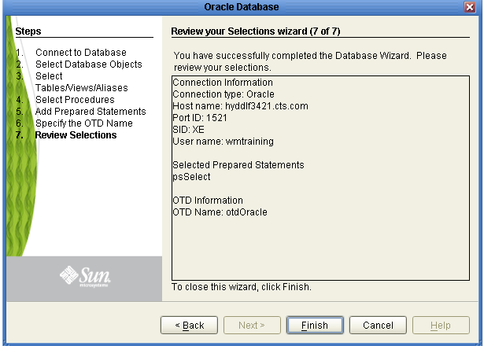
Object Type Definition
(Screen Shot 7)

Slide 10
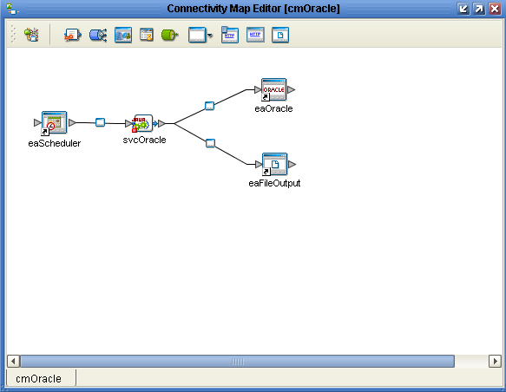
Connectivity Map

Slide 11
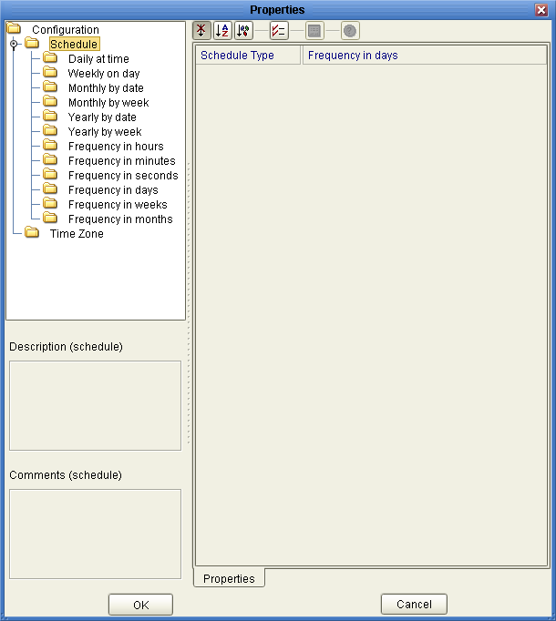
Scheduler Configuration Properties
( eaScheduler -> svcOracle)

Slide 12
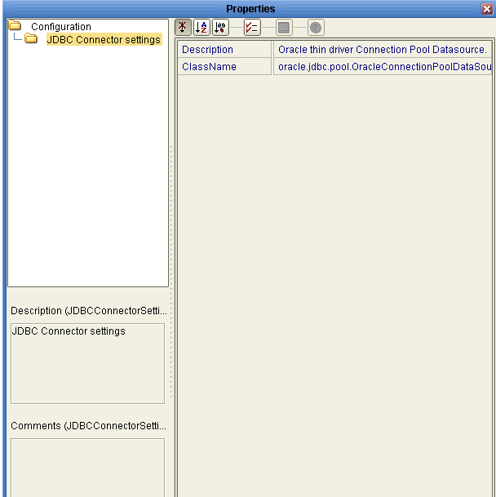
Oracle Configuration Properties
( svcOracle -> eaOracle)

Slide 13
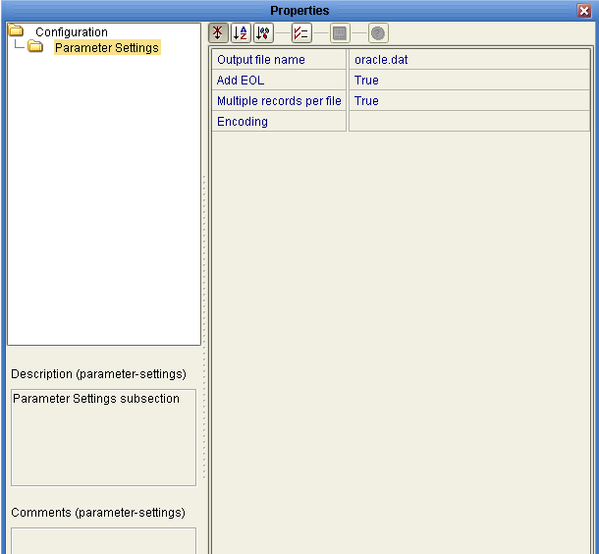
External File Configuration Properties
( svcOracle -> eaFileOutput)

Slide 14
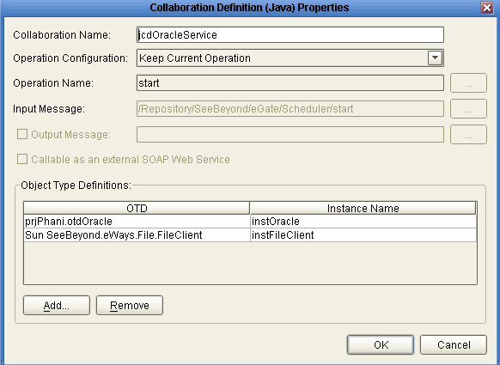
Java Collaboration
(svcOracle)

Slide 15
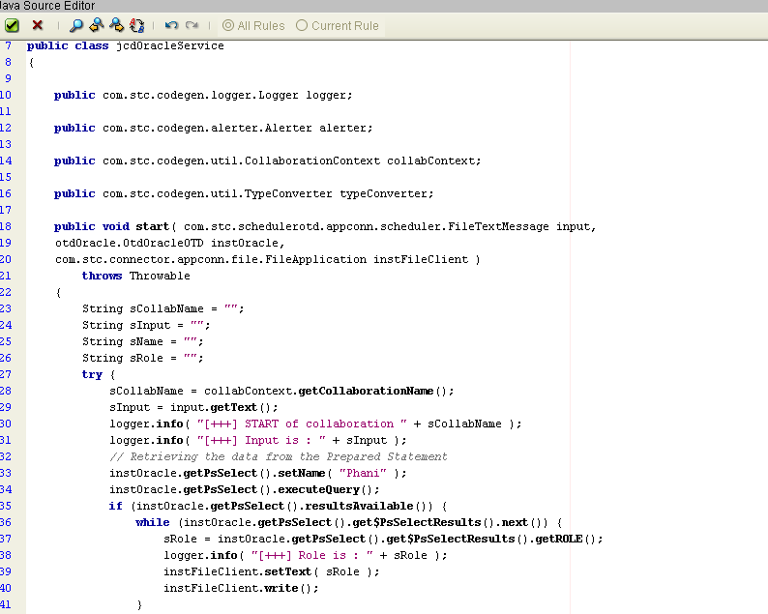
Jcd Code
(svcOracle)

Slide 16
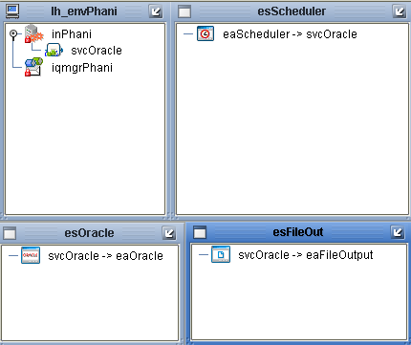
Deployment Profile
(dpOracle)

Slide 17
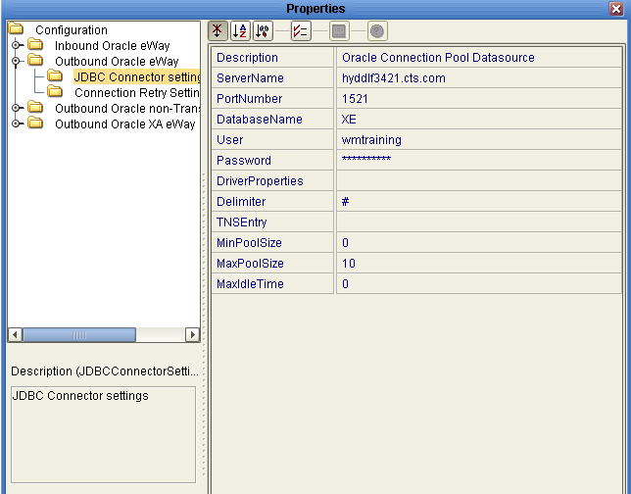
External System - esOracle

Slide 18
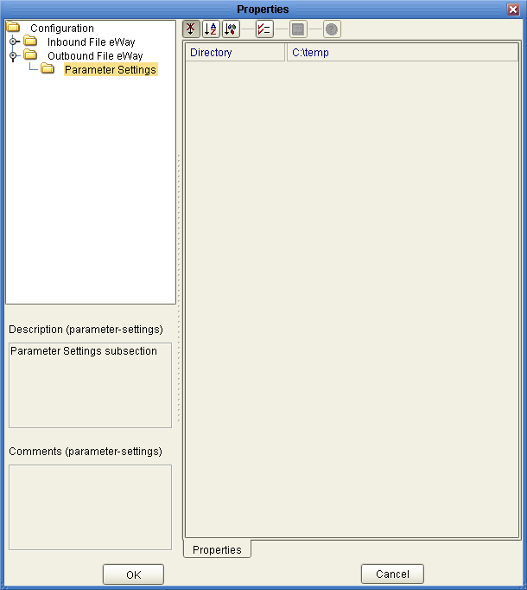
External System - esFileOut

Slide 19
Thank You
Phani Krishna

